Slide 1
The Resilience Prescription
Maggie Blair
Notes:
Hello, and welcome to Sheffield Health and Care Partnership’s series of short development sessions. This one is on Resilience

Slide 2
The Resilience Prescription Charney and Southwick (2007)
Notes:
Dr’s Dennis S Charney and Steven Southwick identified personality traits associated with resilience in American POWs during the Vietnam War who were held captive for up to 8yrs. Remarkably, years after their release, they had a lower-than-expected incidence of depression and PTSD. To determine how these men, mostly pilots, handled such a high pressure experience yet in many cases came out stronger than before.
In two other studies, they interviewed a group of women who had suffered severe trauma and a group of people who showed courage and resilience while facing serious medical problems. They found that the same characteristics of resilience in the POWs were present in these other two groups
Charney believes that you can learn to recognize your own character strengths and engage them to deal with difficult and stressful situations he explained. “We all have things we can do very well. The idea is to build on them when you are faced with stressful situations.”

Slide 3
The Resilience Prescription Dennis S Charney (2007)
Resilient role model
Personal Moral compass - sense of purpose
Signature strengths
Positive attitudes and emotions
Learning to re-frame
Challenge and Mastery
Physical Health
Supportive social networks
Notes:
Dr’s Dennis S Charney and Steven Southwick identified personality traits associated with resilience in American POWs during the Vietnam War who were held captive for up to 8yrs. Remarkably, years after their release, they had a lower-than-expected incidence of depression and PTSD. To determine how these men, mostly pilots, handled such a high pressure experience yet in many cases came out stronger than before.
In two other studies, they interviewed a group of women who had suffered severe trauma and a group of people who showed courage and resilience while facing serious medical problems. They found that the same characteristics of resilience in the POWs were present in these other two groups
Charney believes that you can learn to recognize your own character strengths and engage them to deal with difficult and stressful situations he explained. “We all have things we can do very well. The idea is to build on them when you are faced with stressful situations.”

Slide 4
The Resilience Prescription Dennis S Charney (2007)
Resilient role model
Personal Moral compass - sense of purpose
Signature strengths
Positive attitudes and emotions
Learning to re-frame
Challenge and Mastery
Physical Health
Supportive social networks
Notes:
Dr’s Dennis S Charney and Steven Southwick identified personality traits associated with resilience in American POWs during the Vietnam War who were held captive for up to 8yrs. Remarkably, years after their release, they had a lower-than-expected incidence of depression and PTSD. To determine how these men, mostly pilots, handled such a high pressure experience yet in many cases came out stronger than before.
In two other studies, they interviewed a group of women who had suffered severe trauma and a group of people who showed courage and resilience while facing serious medical problems. They found that the same characteristics of resilience in the POWs were present in these other two groups
Charney believes that you can learn to recognize your own character strengths and engage them to deal with difficult and stressful situations he explained. “We all have things we can do very well. The idea is to build on them when you are faced with stressful situations.”

Slide 5
The Resilience Prescription Dennis S Charney (2007)
Resilient role model
Personal Moral compass - sense of purpose
Signature strengths
Positive attitudes and emotions
Learning to re-frame
Challenge and Mastery
Physical Health
Supportive social networks
Notes:
Dr’s Dennis S Charney and Steven Southwick identified personality traits associated with resilience in American POWs during the Vietnam War who were held captive for up to 8yrs. Remarkably, years after their release, they had a lower-than-expected incidence of depression and PTSD. To determine how these men, mostly pilots, handled such a high pressure experience yet in many cases came out stronger than before.
In two other studies, they interviewed a group of women who had suffered severe trauma and a group of people who showed courage and resilience while facing serious medical problems. They found that the same characteristics of resilience in the POWs were present in these other two groups
Charney believes that you can learn to recognize your own character strengths and engage them to deal with difficult and stressful situations he explained. “We all have things we can do very well. The idea is to build on them when you are faced with stressful situations.”

Slide 6
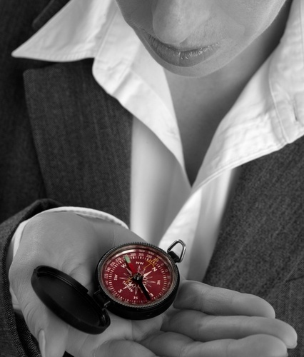
Sense of Purpose: Moral Compass
PERSONAL Moral Compass QUESTIONS
What do I believe in so much that I am willing to take a stand on it – no matter what the cost?
What are my skills, energies, and leadership traits?
What would a “perfect” world look like?
How do I want to contribute to my world?
What do I need to feel free and healthy?
What do I want to learn?
What brings joy to my life?
What is my unique calling or purpose?
Five years from now, I am proudest of . . .
The thirty things I want to do before I die are . . .
Notes:
Studies show that people who show resilience in tough circumstances can answer these questions
Reflect on these questions – can you answer them all? If not, one action from this is to spend some time thinking about
Short de-brief – ask group if there were any they found particularly difficult to answer.

Slide 7
The Resilience Prescription Dennis S Charney (2007)
Resilient role model
Personal Moral compass - sense of purpose
Signature strengths
Positive attitudes and emotions
Learning to re-frame
Challenge and Mastery
Physical Health
Supportive social networks
Notes:
Dr’s Dennis S Charney and Steven Southwick identified personality traits associated with resilience in American POWs during the Vietnam War who were held captive for up to 8yrs. Remarkably, years after their release, they had a lower-than-expected incidence of depression and PTSD. To determine how these men, mostly pilots, handled such a high pressure experience yet in many cases came out stronger than before.
In two other studies, they interviewed a group of women who had suffered severe trauma and a group of people who showed courage and resilience while facing serious medical problems. They found that the same characteristics of resilience in the POWs were present in these other two groups
Charney believes that you can learn to recognize your own character strengths and engage them to deal with difficult and stressful situations he explained. “We all have things we can do very well. The idea is to build on them when you are faced with stressful situations.”

Slide 8
Signature Strengths Exercise
What would your closest friends and family say were your strengths?
Make a list
Consider how you use them
How can you use them more?

Slide 9
The Resilience Prescription Dennis S Charney (2007)
Resilient role model
Personal Moral compass - sense of purpose
Signature strengths
Positive attitudes and emotions
Learning to re-frame
Challenge and Mastery
Physical Health
Supportive social networks
Notes:
Dr’s Dennis S Charney and Steven Southwick identified personality traits associated with resilience in American POWs during the Vietnam War who were held captive for up to 8yrs. Remarkably, years after their release, they had a lower-than-expected incidence of depression and PTSD. To determine how these men, mostly pilots, handled such a high pressure experience yet in many cases came out stronger than before.
In two other studies, they interviewed a group of women who had suffered severe trauma and a group of people who showed courage and resilience while facing serious medical problems. They found that the same characteristics of resilience in the POWs were present in these other two groups
Charney believes that you can learn to recognize your own character strengths and engage them to deal with difficult and stressful situations he explained. “We all have things we can do very well. The idea is to build on them when you are faced with stressful situations.”

Slide 10
Research studies show that Positive Emotional States:
Increase our peripheral vision
We connect ideas better, more creative
We connect with people better
Improve decision-making
Increase a sense of “we” v “me”

Slide 11
Research studies show that Positive Emotional States:
Reduce a sense of them and us
Increase open-mindedness, curiosity
Promote helping-behaviour (altruism)
Stimulate emotional agility

Slide 12
Research studies show that Positive Emotional States:
More able to handle complexity
Greater willingness to accommodate ambiguity or uncertainty
Promotes physical health
Prolongs life by 7-10 years

Slide 13
Positive Emotional States Build Resilience and Contentment
Joy
Gratitude
Serenity
Interest
Hope
Pride
Amusement
Inspiration
Awe
Love

Slide 14
The Resilience Prescription Dennis S Charney (2007)
Resilient role model
Personal Moral compass - sense of purpose
Signature strengths
Positive attitudes and emotions
Learning to re-frame
Challenge and Mastery
Physical Health
Supportive social networks
Notes:
Dr’s Dennis S Charney and Steven Southwick identified personality traits associated with resilience in American POWs during the Vietnam War who were held captive for up to 8yrs. Remarkably, years after their release, they had a lower-than-expected incidence of depression and PTSD. To determine how these men, mostly pilots, handled such a high pressure experience yet in many cases came out stronger than before.
In two other studies, they interviewed a group of women who had suffered severe trauma and a group of people who showed courage and resilience while facing serious medical problems. They found that the same characteristics of resilience in the POWs were present in these other two groups
Charney believes that you can learn to recognize your own character strengths and engage them to deal with difficult and stressful situations he explained. “We all have things we can do very well. The idea is to build on them when you are faced with stressful situations.”

Slide 15
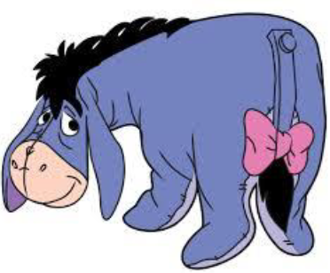
Reframing
“It’s snowing still”, said Eeyore gloomily.
“So it is.”
“And freezing.”
“Is it?”
“Yes,” said Eeyore. “However,” he said
brightening up a little,
“We haven’t had an earthquake lately.”
AA Milne Winnie The Pooh

Slide 16
The Resilience Prescription Dennis S Charney (2007)
Resilient role model
Personal Moral compass - sense of purpose
Signature strengths
Positive attitudes and emotions
Learning to re-frame
Challenge and Mastery
Physical Health
Supportive social networks
Notes:
Dr’s Dennis S Charney and Steven Southwick identified personality traits associated with resilience in American POWs during the Vietnam War who were held captive for up to 8yrs. Remarkably, years after their release, they had a lower-than-expected incidence of depression and PTSD. To determine how these men, mostly pilots, handled such a high pressure experience yet in many cases came out stronger than before.
In two other studies, they interviewed a group of women who had suffered severe trauma and a group of people who showed courage and resilience while facing serious medical problems. They found that the same characteristics of resilience in the POWs were present in these other two groups
Charney believes that you can learn to recognize your own character strengths and engage them to deal with difficult and stressful situations he explained. “We all have things we can do very well. The idea is to build on them when you are faced with stressful situations.”

Slide 17
Challenge & Mastery
Comfort
Stretch
Panic
There is a fine line between positive challenge and negative pressure

Slide 18
Challenge & Mastery
Comfort
Stretch
Panic
There is a fine line between positive challenge and negative pressure

Slide 19
Outcomes of Challenge & Mastery
Makes you feel in control in a greater variety of situations
Mastering different things increases your general confidence in your ability
Links to personality – harder for some than others
Tools for mastery:
Develop and train regularly in multiple areas
Use reframing techniques to have a more realistic perception of events

Slide 20
The Resilience Prescription Dennis S Charney (2007)
Resilient role model
Personal Moral compass - sense of purpose
Signature strengths
Positive attitudes and emotions
Learning to re-frame
Challenge and Mastery
Physical Health
Supportive social networks
Notes:
Dr’s Dennis S Charney and Steven Southwick identified personality traits associated with resilience in American POWs during the Vietnam War who were held captive for up to 8yrs. Remarkably, years after their release, they had a lower-than-expected incidence of depression and PTSD. To determine how these men, mostly pilots, handled such a high pressure experience yet in many cases came out stronger than before.
In two other studies, they interviewed a group of women who had suffered severe trauma and a group of people who showed courage and resilience while facing serious medical problems. They found that the same characteristics of resilience in the POWs were present in these other two groups
Charney believes that you can learn to recognize your own character strengths and engage them to deal with difficult and stressful situations he explained. “We all have things we can do very well. The idea is to build on them when you are faced with stressful situations.”

Slide 21
The Resilience Prescription Dennis S Charney (2007)
Resilient role model
Personal Moral compass - sense of purpose
Signature strengths
Positive attitudes and emotions
Learning to re-frame
Challenge and Mastery
Physical Health
Supportive social networks
Notes:
Dr’s Dennis S Charney and Steven Southwick identified personality traits associated with resilience in American POWs during the Vietnam War who were held captive for up to 8yrs. Remarkably, years after their release, they had a lower-than-expected incidence of depression and PTSD. To determine how these men, mostly pilots, handled such a high pressure experience yet in many cases came out stronger than before.
In two other studies, they interviewed a group of women who had suffered severe trauma and a group of people who showed courage and resilience while facing serious medical problems. They found that the same characteristics of resilience in the POWs were present in these other two groups
Charney believes that you can learn to recognize your own character strengths and engage them to deal with difficult and stressful situations he explained. “We all have things we can do very well. The idea is to build on them when you are faced with stressful situations.”

Slide 22
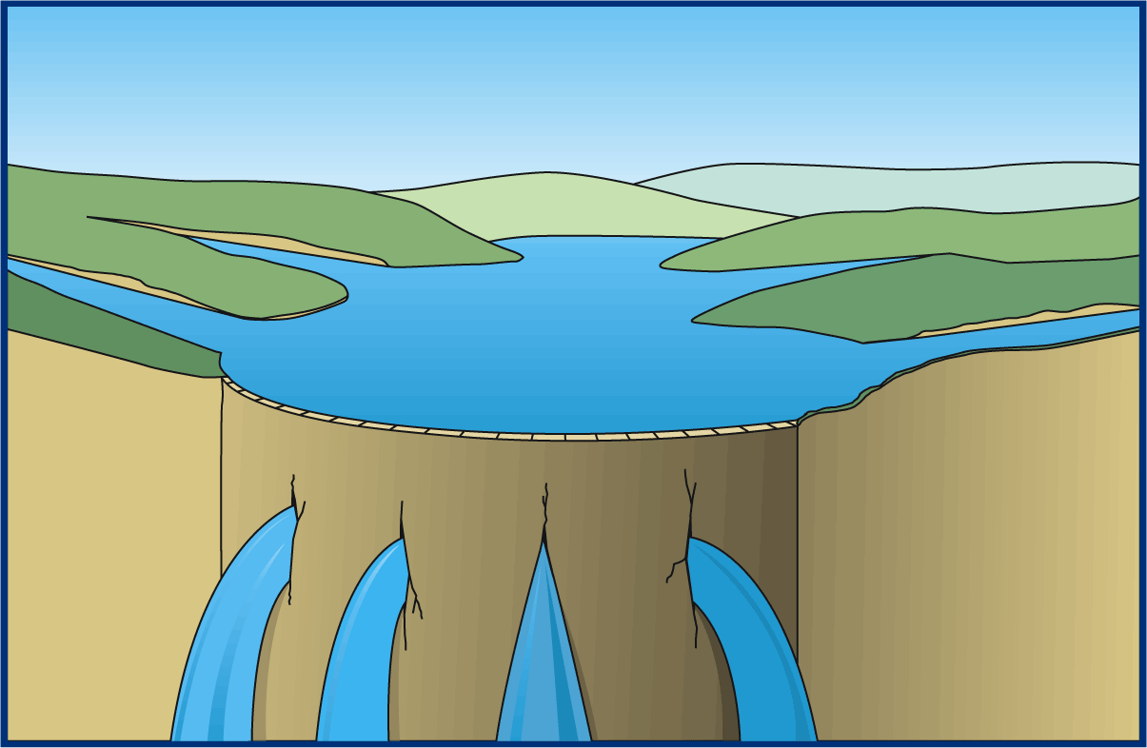
The Reservoir of Well-Being
Learning & Development
Fair rewards
Respect & attention
What tops
you up?
What Drains you?
Notes:
So what causes us to move around the pressure performance curve?
Analogy is that people have a reservoir of psychological well being and events or relationships can be a drain on the reservoir
Damage to psychological well being occurs when people are living or working (or both) in a situation that does not allow the well‐being reservoir to be maintained and topped up. Replenishing sources vary considerably person-to-person but some examples are included on the diagram.
Resilience is about ensuring you have factors which continually replenish your reservoir
REFER TO WORKBOOK EXERCISE
22

Slide 23
The Resilience Prescription Dennis S Charney (2007)
Resilient role model
Personal Moral compass - sense of purpose
Signature strengths
Positive attitudes and emotions
Learning to re-frame
Challenge and Mastery
Physical Health
Supportive social networks
Notes:
Dr’s Dennis S Charney and Steven Southwick identified personality traits associated with resilience in American POWs during the Vietnam War who were held captive for up to 8yrs. Remarkably, years after their release, they had a lower-than-expected incidence of depression and PTSD. To determine how these men, mostly pilots, handled such a high pressure experience yet in many cases came out stronger than before.
In two other studies, they interviewed a group of women who had suffered severe trauma and a group of people who showed courage and resilience while facing serious medical problems. They found that the same characteristics of resilience in the POWs were present in these other two groups
Charney believes that you can learn to recognize your own character strengths and engage them to deal with difficult and stressful situations he explained. “We all have things we can do very well. The idea is to build on them when you are faced with stressful situations.”

