Slide 1
RACI
Maggie Blair
Notes:
Hello, and welcome to Sheffield Health and Care Partnership’s series of short development sessions. This one is on RACI

Slide 2
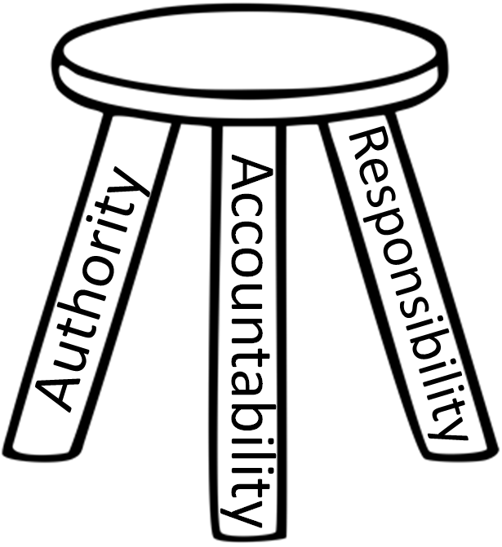
Notes:
We can think of responsibility, authority and accountability as a three-legged stool – remove one leg and . . .

Slide 3
Responsibility
Accountability
Authority
Notes:
. . . the situation falls over. We’re going to spend some time in this session looking at these three things and working through a tool that can support system working by ensuring that responsibility and accountability are appropriately apportioned and giving clarity around the four levels of responsibility.

Slide 4
Definitions
Responsible - having an obligation to do something . . . as part of one’s job or role
Authority - the power or right to give orders, make decisions and enforce obedience
Accountable - a person required or expected to justify decisions / actions
Notes:
Let’s start with some definitions and then look at each element in a bit more detail: slide contents

Slide 5
Responsibility
Ownership + impact
Two way process, both allocated and accepted

Slide 6
Responsibility
Allocated
Pause
Accepted
Notes:
Responsibility is a two way process, both allocated and accepted. It can’t just be allocated, it must be accepted by the person receiving it, along with the appropriate amount of . . .

Slide 7
Authority
Right to act in areas where one is given and
accepts responsibility
Levels of authority:
Level 1: Data/information/idea gathering
Level 2: Data/information/idea gathering +
recommendations
Level 3: Data/information/idea gathering +
recommendations (Pause to
communicate, clarify or negotiate) + Act
Level 4: Act and inform others after taking action – full authority to act
Notes:
. . . authority.
There are four levels of authority. Let’s illustrate this by considering giving someone the responsibility of organizing a Christmas party for the organisation.
Level 1 – you expect them to gather ideas for menus, costs, availability
Level 2 – you also expect a recommendation as to which venue / menu / price to charge
Level 3 – you expect the above, then communication back to you for further discussion and then authority from you to go ahead and make the necessary arrangements, and finally:
Level 4 – you expect them to do all of the above without needing to come back to you for further permission.
The level of authority you allocate will depend on their level of experience, ability and competence.

Slide 8
Accountability
Reflecting on actions and decisions
Evaluating effectiveness
Directing future efforts
Promoting learning

Slide 9
Introduction to RACI
Who is Responsible?
The person who is assigned to do the work
R
Who is Accountable?
The person who makes the final decision and has the ultimate ownership
A
Who is consulted?
The person who must be consulted before a decision or action is taken
C
Who is informed?
The person who must be informed that a decision or action has been taken
I
Notes:
So RACI is a tool which helps you to bring clarity to a situation by allocating each component part of responsibility, accountability, consultation and information to the stakeholders

Slide 10
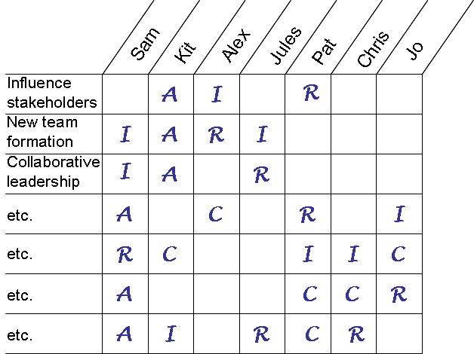
RACI – A practical and pragmatic tool to help clarify roles and responsibilities
Responsible
“Doers” who act on or implement decisions. The degree of responsibility is determined by the person who is accountable. There can be more than one responsible person.
Accountable
“The buck stops here” because this person is uniquely accountable and has power of veto. There can only be one accountable person in each row.
Consulted
This person is “in the loop” and should be consulted prior to decisions or actions. Two-way communication.
Informed
This person needs to know about decisions or actions on an “FYI” basis after the fact. One-way communication.
Notes:
Draw up a matrix with all the stakeholders or stakeholder groups along the top and the various stages of the process down the left hand side.
Then work through it, preferably with others and preferably with the stakeholders - and allocate responsibility, accountability, consultation and information. There can be more than one stakeholder to each stage, and more than one stage to each stakeholder, BUT only one person can be accountable for each stage.

Slide 11
Questions to consider
What is the responsibility of each role in respect of this issue?
What is your authority to act?
Who is accountable?
How will you work together in this scenario
What would your role be?
If, e.g., you were looking at flow, do you understand what your role is in relation to each other?
Notes:
Here’s some guidelines of what to think about when you carry out the exercise

Slide 12
Issues
Does someone have too much responsibility? Delegate to a more appropriate role or use as a development opportunity for others
Is someone not performing? Use the tool to hold a conversation to introduce the subject and resolve this
Use (informally if appropriate) at the beginning of a project to give clarity from the start
Highlights who else needs to be involved. Accountability without authority is problematic in the extreme
Notes:
Once you have worked through the exercise, consider these issues

Slide 13
Further reflection
What issues has this highlighted that need resolving?
How might you do this?
Who else needs to be involved?
Any further reflections?
Notes:
RACI will help you to highlight issues that need resolving – for example an individual, group or organisation that isn’t meeting their responsibilities. Consider how you might address this. Is there anyone else who needs to be involved? Is there anything further that needs to be considered?

Slide 14
RACI
Maggie Blair
maggie.blair@nhs.net
Notes:
Hello, and welcome to Sheffield Health and Care Partnership’s series of short development sessions. This one is on RACI

