Slide 1
Change
Maggie Blair
Notes:
Hello, and welcome to Sheffield Health and Care Partnership’s series of short development sessions. This one is on Change

Slide 2
“The only constant is change . . .”
. . . how it feels and how to handle it . . .
Notes:
Change is a constant across our Health and Social Care system. We’re forever innovating, refining our services . . . Or being reorganised! Understanding change – how it impacts you and others, and how to handle it, is key. In this session we’ll look at all of this and give you some models to help you navigate your way through it.

Slide 3
Self
Actualisation
Esteem Needs
Social Needs
Safety Needs
Physiological Needs
Notes:
Maslow's hierarchy of needs is a theory of psychology which states that humans are motivated to fulfill their needs in a hierarchical order. This order begins with the most basic needs before moving on to more advanced needs.
It’s useful to understand that our employment impacts something at every level of the hierarchy and therefore, when that is under threat – however small – we have a response to it, however small.

Slide 4
Physiological Needs
Notes:
Maslow’s Hierarchy begins with physiological needs. In terms of how our employment impacts Maslow, think of this as the ability to buy . . .

Slide 5
Food
Notes:
. . . food.
Our employment allows us to buy food through our salary and therefore impacts the most basic of our needs – survival.

Slide 6
Safety Needs
Notes:
The next level is our safety needs, or, in the case of our employment affecting this . . .

Slide 7
Employment
Health
Property
Notes:
. . .

Slide 8
Social Needs

Slide 9
Friendship

Slide 10
Esteem Needs

Slide 11
Self-esteem
Confidence
Achievement
Respect of others
Respect by others

Slide 12
Self
Actualisation

Slide 13
Self
Actualisation
Esteem Needs
Social Needs
Safety Needs
Physiological Needs
Notes:
Finally, recap with the Maslow Levels slide . . .

Slide 14
Self
Actualisation
Self-esteem
Confidence
Achievement
Respect of others
Respect by others
Friendship
Employment
Health
Property
Food
Notes:
. . . And consolidate with this slide

Slide 15
Eight Reasons for Resisting Change
No reasons to change
Fear of loss of power
Lack of resources
Bad timing
Habit
Fear of the unknown
Lack of good information
Fear of loss of security
M
Notes:
No reasons to change
No ‘felt need’ on their part – they don’t see the point of it
Fear of loss of power
‘Mavis’ has always done that job; nobody other than Mavis knows how to do that job; Mavis is needed to do that job; therefore Mavis has power. Make any changes to that role and Mavis loses her power
Lack of resources
Fear that they won’t be able to implement what is coming
Bad timing
On top of everything else they’re coping with, it’s going to be tough
Habit
Some people have a negative knee-jerk reaction to change
Fear of the unknown
What it says on the tin – people are afraid of what they don’t know
Lack of good information
Critical to have good information available in order to justify the change and show people the new path
Fear of loss of security
Anxiety around potential loss of employment / downbanding etc..

Slide 16
Bridge’s Transition Model
“It isn’t the changes that do you in, it’s the transitions.
Change is situational, transition is the psychological process people go through to come to terms with the new situation.
Change is external, transition is internal.”
William Bridge
M

Slide 17
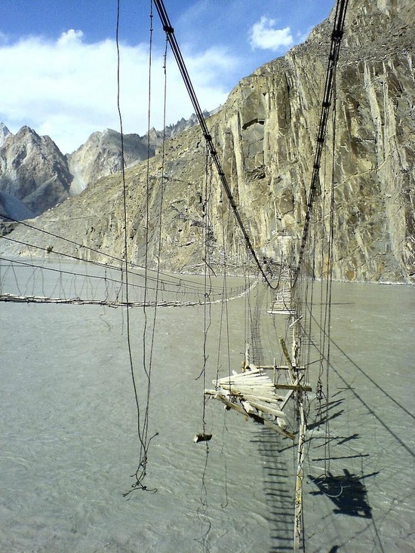
Notes:
It’s useful that this model is called ‘Bridge’ – it gives me the opportunity to illustrate how change feels using these pictures!:
It can feel incredibly unsafe – rickety and dangerous

Slide 18
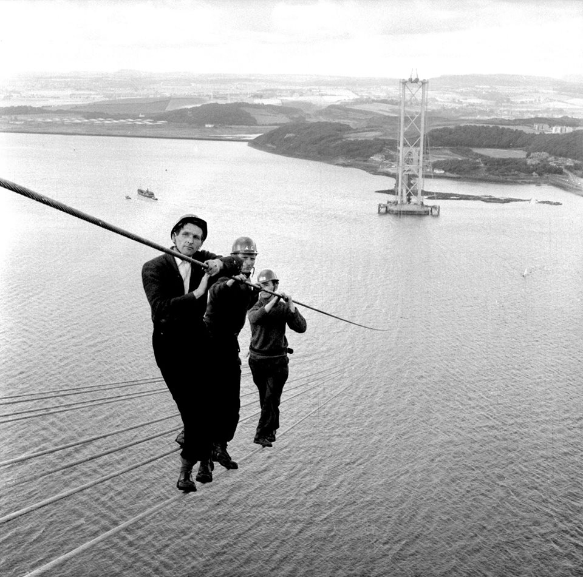
Notes:
Even when some safety structures are in place, it can still be frightening

Slide 19
Notes:
It can feel incredibly lonely . . . there is a man on there all on his own, if you look closely!

Slide 20
Notes:
But really, this is what change is actually like in the NHS – long, unending, repeated over and over, but ultimately relatively smooth and safe.

Slide 21
New Goals
Retreat
Emotion
Taking
Stock
Self
Doubt
Shock
Resolve
Apathy
Time
Information
/ Emotional Guidance /Communication / Support
/ Direction
Kubler – Ross Change Curve
Notes:
. . . but that this is the clearest.
Based on the grief curve, it reminds us that, with ANY change, people go through this curve. They may go through it with a greater or lesser degree of emotion and it may take some people a greater or lesser amount of time than others, but everyone ALWAYS go through it. Whether it be something as small as changing your route on the way into work or a major life change, everyone goes through it
The text at the bottom is the support required at each stage
Talk about the importance of understanding this curve for yourself, so that you can identify where you are on it – and for others, so that you can see when others are struggling and help them through it. I always talk about being stuck in apathy and not understanding it at the time and thinking I was losing my mind. Once I understood what was going on, I was through it by the end of the day, but I needed that understanding to help me cope. That won’t work for everyone, but it can still help them to cope
Then move into the next slides which look at how people react to change and how to handle it

Slide 22
Endings
Denial, characterised by disbelief and shock
May evolve from the initial shock into resentment
“It can’t be. How could they do this?”
Stress can be high
May fight to preserve the old system or manoeuvre to hold on to the old
May affect both positive and perceived negative change equally
M
Notes:
There are three phases of change which need to be managed
People react to the ending of things in these ways – work through them and discuss briefly

Slide 23
Endings
Think about why ending is necessary
Be clear about what is ending and what isn’t
Allow for resistance and grieving over the loss in a variety of ways with differing timelines
Find ways to honour (not denigrate) the past
Take a piece of the past with you
M
Notes:
Suggestions as to how to manage this phase

Slide 24
Neutral Zone
Disorientation
Beginning to let go
Discomfort when starting to let go of the old but not yet embracing the new one
Confusion
Testing new behaviours, procedures, processes
Withdrawal or self-pity
Allow yourself to vent appropriately
Lack of focus
M
Notes:
The middle phase – again, reactions that may emerge

Slide 25
Neutral Zone
Acknowledge discomfort
Recognise that others may not be as understanding or as enthusiastic about the new beginnings as you are
Avoid giving pep talks before people are ready for them
M
Notes:
Suggestions as to how to manage this phase

Slide 26
Beginnings
New energy emerges
Initial, limited risk-taking
Gaining some traction for new behaviours procedures and processes
Beginning to feel included in change
Forming an attachment to new processes and systems
Beginning to see the new possibilities and feel excitement
M
Notes:
Finally what happens in the final phase

Slide 27
Beginnings
Identify the part you will play in the new system
Be aware of your behaviours and ensure you model the required behaviour
Celebrate success
M
Notes:
Suggestions as to how to manage this phase

Slide 28
Defining
your role in
the process
Recognising the impact of your inner voices
Identifying knowledge,skills and behaviours that will help

Slide 29
Listener
Friend
Coach
Motivator
Visionary
Mentor
Communicator
Catalyst
Planner
Realist
Defining
your role in
the process
Notes:
There are many roles you may adopt – you may be one of these, you may be all of these. You’ll almost certainly, as a leader, be half a dozen of these. Identify which roles you are taking, and which of your strengths you will need to draw on to help you fulfil those roles. And ensure your behaviours match the desried outcome and that you model them consistently.

Slide 30
Reflection
What do you consider your strengths to be when it comes to change?
What strengths do you need to develop to help you to better cope with change?

Slide 31
New Goals
Retreat
Emotion
Taking
Stock
Self
Doubt
Shock
Resolve
Apathy
Time
Information
/ Emotional Guidance /Communication / Support
/ Direction
_{Kubler – Ross Change Curve}
Notes:
. . . but that this is the clearest.
Based on the grief curve, it reminds us that, with ANY change, people go through this curve. They may go through it with a greater or lesser degree of emotion and it may take some people a greater or lesser amount of time than others, but everyone ALWAYS go through it. Whether it be something as small as changing your route on the way into work or a major life change, everyone goes through it
The text at the bottom is the support required at each stage
Talk about the importance of understanding this curve for yourself, so that you can identify where you are on it – and for others, so that you can see when others are struggling and help them through it. I always talk about being stuck in apathy and not understanding it at the time and thinking I was losing my mind. Once I understood what was going on, I was through it by the end of the day, but I needed that understanding to help me cope. That won’t work for everyone, but it can still help them to cope
Then move into the next slides which look at how people react to change and how to handle it

Slide 32
Change
Maggie Blair
maggie.blair@nhs.net
Notes:
Hello, and welcome to Sheffield Health and Care Partnership’s series of short development sessions. This one is on Change

