Slide 1
Appreciative Inquiry (4D)
Maggie Blair
Notes:
Hello, and welcome to Sheffield Health and Care Partnership’s series of short development sessions. This one is on Appreciative Inquiry, or 4D

Slide 2
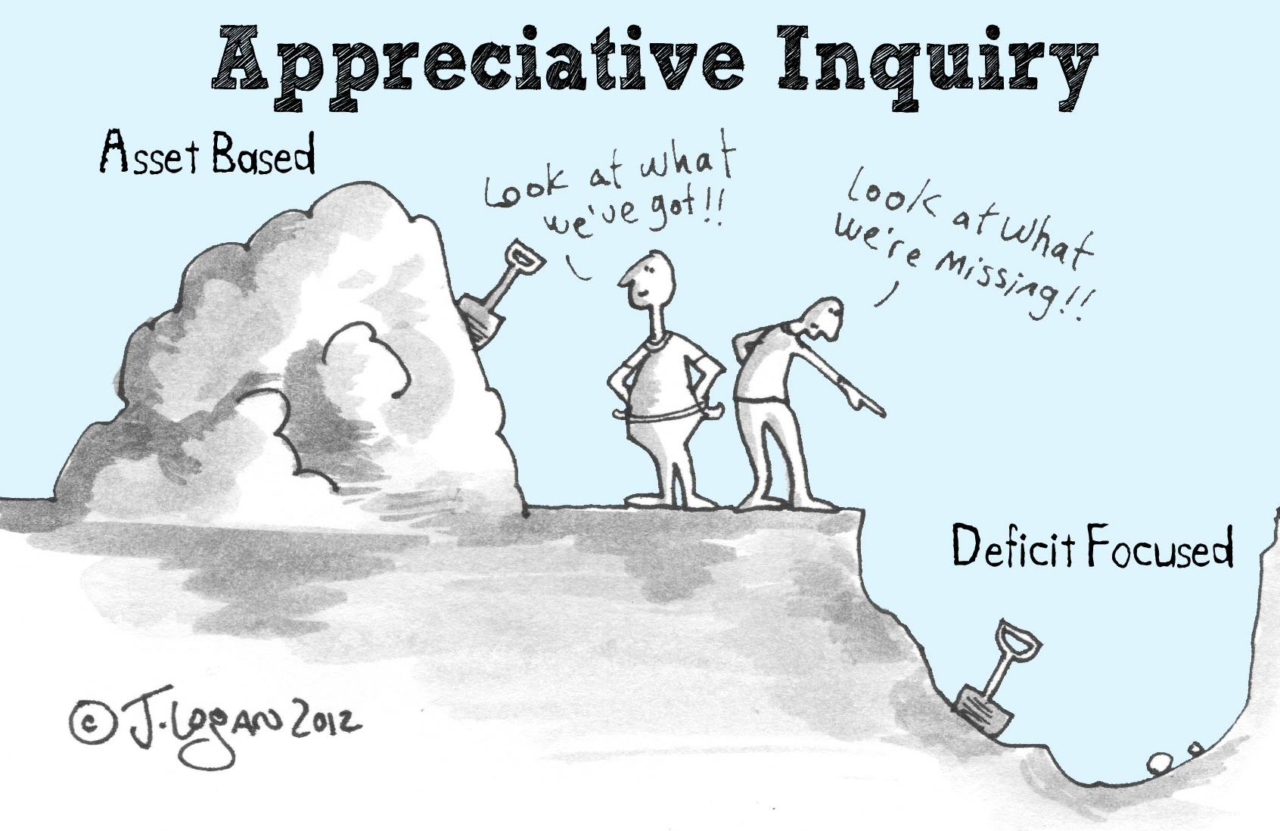
Notes:
Appreciative Inquiry is an asset-based way of looking at issues, rather than deficit-based – looking at the positives, rather than the negatives. It’s a tool that you can workshop for a whole day or spend five minutes thinking on your own about any issue – personal or work, and is ideal for system working as it surfaces assets that would otherwise go unnoticed.

Slide 3
4D inquiry model
Discover
Dream
Design
Destiny
Affirmative Topic
Notes:
So let’s have a look at the model and how it works. It begins with selecting an affirmative topic – what you’re actually going to discuss or think about.
Whatever you put your energy into grows, whatever you ask about, you get more stories about. Put thought into your affirmative topic - make sure its saying what you want and not what you don’t want! Flip if necessary eg. ‘supervision not taking place’ – ‘appreciate supervision’ , ‘breakdown of relationships in the team’ – ‘engage team making a real difference to the service’
DISCOVER: The identification of what works well.
DREAM: The envisioning of what would work well in the future.
DESIGN: Planning and prioritizing what needs to be in place to realise the dream.
DESTINY: The implementation of the proposed design

Slide 4
DISCOVER
Ask questions and appreciate what is
Notes:
So tell me about a time when you’ve achieved rea excellence in audio typing and report writing?
Tell me your stories of excellence in audio typing and report formatting.
Can you give me an example of how you currently show your strengths in audio typing and report formatting?
Talk to me about your thinking on…….

Slide 5
Dream
Imagine what could be
Notes:
Dreaming is expansive and provocative.
Dream as if you know nothing of what currently exists as that might inhibit your expanded thinking…..no barriers, no limitations, let yourself free!!
What is the story in CaF about audio typing and report formatting that you would like to be telling in 12 months time from now?
What are you and everyone else seeing, hearing, feeling?

Slide 7
DESIGN
Create what will be
Notes:
Design questions encourage big ideas in line with the dreaming conversation.
What questions will help to discover/explore positive and creative ideas from people about what would need to be in place in terms of relationships and behaviours, process and procedure to make the dream and ambition real?
What big ideas do you have about how the dream could become the reality ?
Design: What ideas do you have on what needs to be in place to make this dream a reality:
Our relationships and behaviours?
Our processes and procedures?

Slide 8
Destiny
Plan the action
Notes:
Destiny: How will we collectively ensure our ideas will be put into action and how will we measure and report the impact?
How will we collectively ensure the ideas become action and how will we capture, measure and report change.
Produce an action plan about what actions need to be taken who is going to do what and by when.

Slide 9
Learn from experience
Look to the future
Decide what needs doing
Action Plan / Make it Happen

Slide 10
Appreciative Inquiry (4D)
Maggie Blair
maggie.blair@nhs.net
Notes:
If you’d like support with a D session for a piece of system working, get in touch

