Slide 1
‘Team Sheffield’ Ageing Well Programme

Slide 2
The Ageing Well Programme
People in England can now expect to live for far longer than ever before – but these extra years of life are not always spent in good health, with many people developing conditions that reduce their independence and quality of life.
A key role for NHS and social care services is to help people prevent / manage these conditions including the use of technologies to support independence for longer
NHS Long Term Plan aims to give people greater control and to shift care and support closer to people’s homes

Slide 3
The ageing Well programme
The National Ageing Well programme has specific work areas aimed at the most frail and vulnerable of our current older generation. These include:
promoting a multidisciplinary approach;
giving people more say about the care and support they receive;
offering more support for people who look after family members, partners or friends;
promoting more rapid community response teams;
and offering more NHS support into care homes.

Slide 4
How are we approaching this work in Sheffield?
In Sheffield we have created a dedicated team who are focussed on delivering the nationally funded Ageing Well Programme within our locality.
The team comprises representation from Health, Social, Voluntary, and Private Organisations who are working in partnership with the people of Sheffield to provide services that deliver ‘what matters’ to our community in line with the NHS England Ageing Well recommendations.

Slide 5
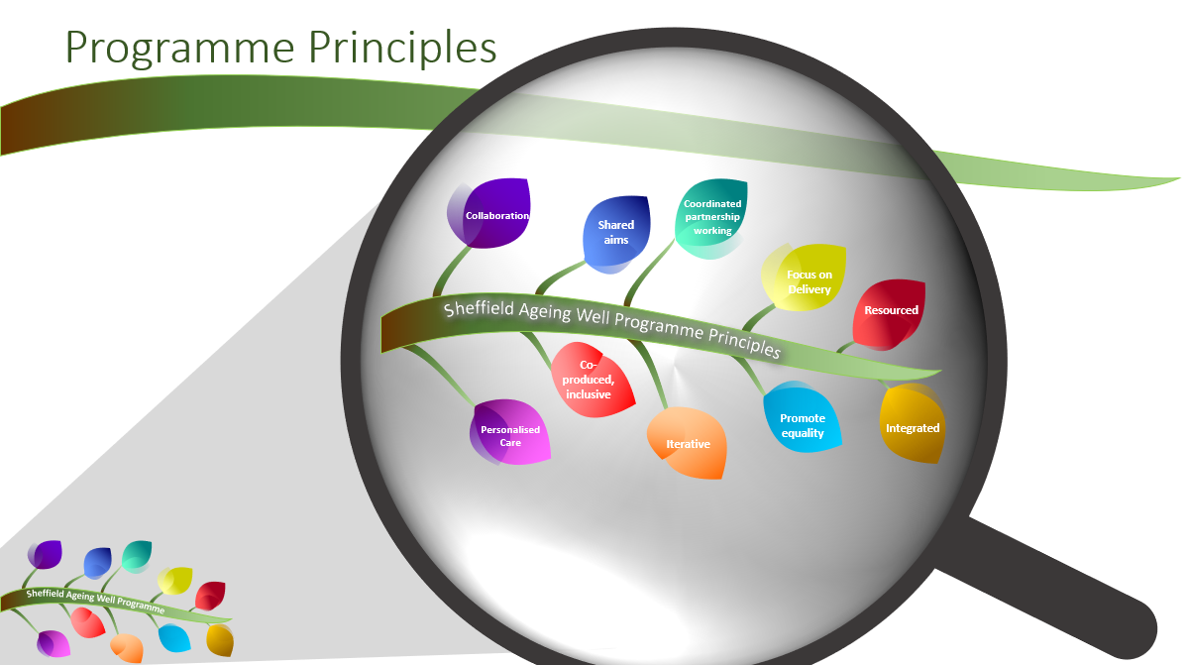

Slide 6
Programme Principles

Slide 7
What Matters to you
Why ask “What matters to you?”
To ensure health and social care teams listen and hopefully understanding what matters to a individuals within the larger context of their life.
To encourage meaningful conversations between people who provide health and social care and the people, families and carers who receive it
When people are engaged with their health and social care decisions, it can greatly improve their outcomes.

Slide 8
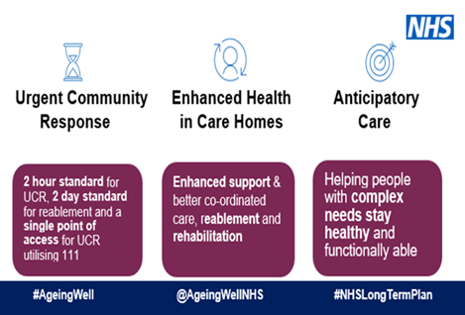
Three Core workstreams within the ageing Well programme

Slide 10
Enhanced Health in Care homes (EHiCH)
People living in care homes should expect the same level of health care support and treatment as if they were living in their own home.
Through working across organisations in a co-ordinated way the individual will receive better, more co-ordinated and proactive care, delivered where they live. To support:
better outcomes for people through better management of their long-term condition(s)
a reduction in unplanned hospital admissions
a reduction in hospital as the place of death.
excellence and equity of care for people living in care homes.
Notes:
Care element
Sub-element
1. Enhanced primary care support
Each care home aligned to a named PCN, which leads a weekly multidisciplinary ‘home round’
Medicine reviews
Hydration and nutrition support
Oral health care
Access to out-of-hours/urgent care when needed
2. Multi-disciplinary team (MDT) support including coordinated health and social care
Expert advice and care for those with the most complex needs
Continence promotion and management
Flu prevention and management
Wound care – leg and foot ulcers
Helping professionals, carers and individuals with needs navigate the health and care system
3. Falls prevention, Reablement and rehabilitation including strength and balance
Rehabilitation/reablement services
Falls, strength & balance
Developing community assets to support resilience and independence
4. High quality palliative and end-of-life care, Mental Health and dementia care
Palliative and end-of-life care
Mental health care
Dementia care
5. Joined-up commissioning and collaboration between health and social care
Co-production with providers and networked care homes
Shared contractual mechanisms to promote integration (including Continuing Healthcare)
Access to appropriate housing options
6. Workforce development
Training and development for social care provider staff
Joint workforce planning across all sectors
7. Data, IT and technology
Linked health and social care data sets
Access to the care record and secure email
Better use of technology in care homes

Slide 11
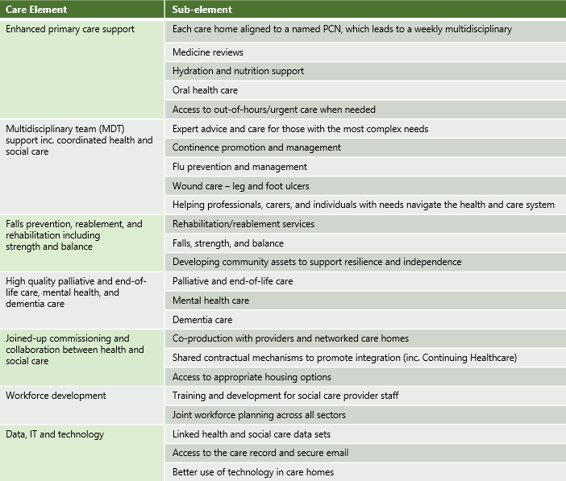
Enhanced Health in Care home Framework
Enhanced Health in Care Homes
Core Elements
Enhanced primary care support
Multi-disciplinary team (MDT) support including coordinated health and social care
Falls prevention, Reablement and rehabilitation including strength and balance
High quality palliative and end-of-life care, Mental Health and dementia care
Joined-up commissioning and collaboration between health and social care
Workforce development
Data, IT and technology
NHS England » Enhanced Health in Care Homes Framework

Slide 12
Enhanced Health in Care homes Delivery in Sheffield
Enhanced Health in Care Homes Collaborative Group
Chair: Sarah Burt, Deputy Director of Commissioning Development (Planned Care)
Meetings held every six weeks
Membership includes:
STH, SCC, SHSC, PCS, ICB, LMC
MDTs
With input from dietetics, SLT and Falls
Workforce Development
Managing the deteriorating patient
Hydration and Nutrition
Falls
Urgent Community Response

Slide 15
Urgent community Response
What is Urgent Community Response?
A community-based crisis response service provided by a multi-skilled team to people in their usual place of residence with an urgent care need (required within two hours) and involves an assessment and short-term intervention(s)

Slide 16
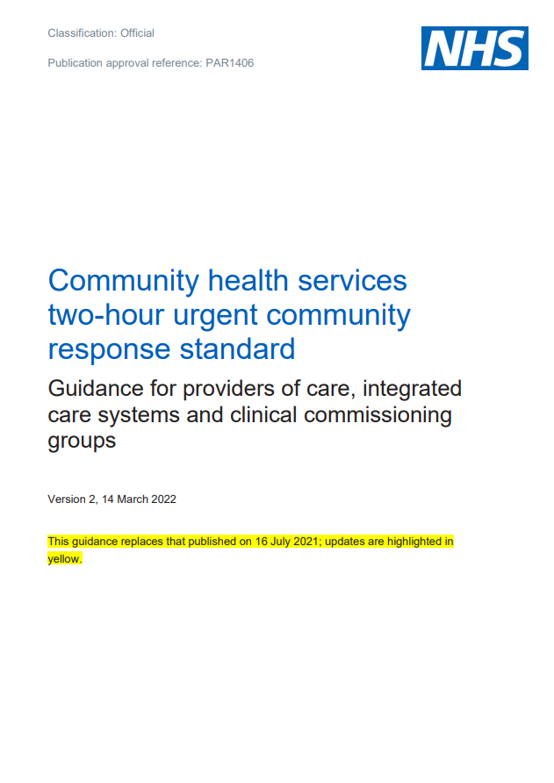
Urgent Community Response (UCR)
Provide services at scale: ensuring full geographical coverage of two-hour crisis response care across every ICS
Ensuring that anyone who requires a two-hour response receives one, regardless of where they live
Provide services from 8am to 8pm, seven days a week, at a minimum
Ensuring that people have access to the same high-quality home-based care at weekends and in the evenings as they do on a weekday
Accept referrals into crisis response services from all appropriate sources
Providing a seamless integrated experience for each person and enabling professionals to easily access the service
Submit complete data returns to the Community Services Data Set (CSDS)
Demonstrating impact by collecting data that will support counting of the national standard; quality improvement and improved patient outcomes and experience
NHS England » Community health services two-hour crisis response standard guidance

Slide 17
Urgent Community Response Delivery in Sheffield
Urgent Community Response Collaborative Group
Chair: Helen Kay, Operations Director, Sheffield Teaching Hospitals
Meetings held every six weeks
Membership includes:
STH, SCC, SHSC, PCS, ICB, YAS, 111, CWCA
Data and Business
Workforce
Clinicals pathways
Communication and Engagement

Slide 20
Anticipatory Care
What is anticipatory Care?
Designed to support those patients who are at high risk of unwarranted health outcomes to live well and independently for longer, through structured proactive care

Slide 21
Anticipatory Care Framework
FurtureNHS have released an Anticipatory Care Framework (DRAFT Aug 2022) and an interventions framework (FINAL Aug 2022)
AC Framework will initially focus on specific sub-populations of people living with multiple long term conditions (two or more) who are at risk of needing unplanned care in the next two years:
People living with frailty
People experiencing health inequalities
People reliant on unplanned care
Excluded from this national cohort are individuals:
Living in care homes
Better served by specialist services
Children and young people
Those with mental health problems
Those requiring specialist palliative care
Notes:
Anticipatory care is delivered through 5 key steps:
Population Cohort Identification
Using risk stratification to identify the cohort most at risk of unwarranted health outcomes
Proactive Care Needs Assessment
Undertake a proactive care needs assessment in a personalised, holistic manner
Determine the individuals health, social and support needs
Personalised Care and Support Planning
Understanding what matters to the person as well as their clinical and support needs
Digitally Enabled Multi-disciplinary Teams
Essential to delivering optimum anticipatory care
Multi-agency and should vary person to person, depending on their need
Care Coordination
Building on the personalised care and support planning
Bring together all the identified information and recommendations for the persons care and support needs
Work with the person and their representatives to coordinate the care and support they receive
Underpinned by:
developing system working across all partners
sharing of relevant data across organisations and sectors and resolving any issues associated with this
implementation of digital tools both for the person and the professionals where appropriate

Slide 22
The anticipatory Care Operating Model
The operating model for Anticipatory Care

Slide 23
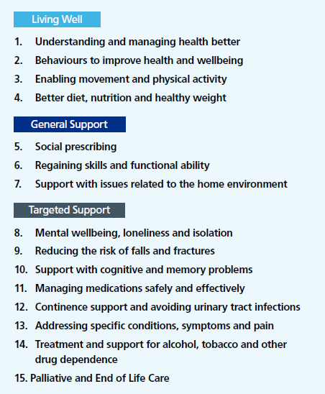
Interventions Framework
The Intervention Framework sets out key areas in which interventions may be effective to address the issues identified during assessment and care planning.
It gives an indication of the types of services and supports that might need to be in place to address the Anticipatory Care requirements of individuals.
Anticipatory Care interventions and support are organised into 15 broad categories, grouped into three main areas:
Living Well
General support to help people live well
Targeted support for specific health issues

Slide 24
Anticipatory Care Delivery in Sheffield
Anticipatory Care Collaborative Group to be established Autumn 2022
Falls
(management of the immediately fallen, prevention and reablement)
Team Around the Person
Respect

Slide 26
Further information and contacts
Further information can be found on the HCP website
Or contact the Sheffield Ageing Well team via:
sth.ageingwell@nhs.net

