Slide 1
Leadership Community session –
Development Session on RACI

Slide 2
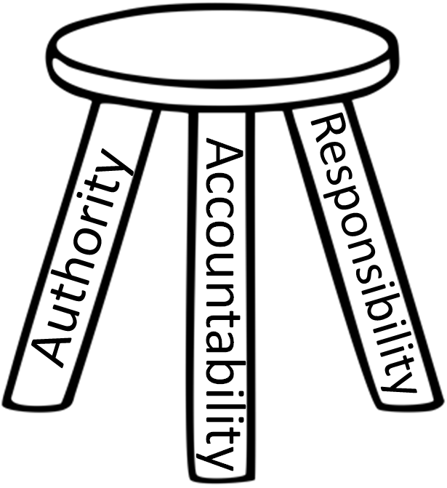

Slide 3
Responsibility
Accountability
Authority

Slide 4
Definitions
Responsible
Authority and
Accountable

Slide 5
Definitions
Responsible - having an obligation to do something . . . as part of one’s job or role
Authority - the power or right to give orders, make decisions and enforce obedience
Accountable - a person required or expected to justify decisions / actions

Slide 6
RESPONSIBILITY
ALLOCATED
PAUSE
ACCEPTED

Slide 7
Responsibility
Ownership + impact
Two way process, both allocated and accepted

Slide 8
Authority
Right to act in areas where one is given and
accepts responsibility
Levels of authority:
Level 1: Data/information/idea gathering
Level 2: Data/information/idea gathering +
recommendations
Level 3: Data/information/idea gathering +
recommendations (Pause to
communicate, clarify or negotiate) + Act
Level 4: Act and inform others after taking action – full
authority to act

Slide 9
Accountability
Reflecting on actions and decisions
Evaluating effectiveness
Directing future efforts
Promoting learning

Slide 10
Introduction to RACI
R
Who is Responsible?
The person who is assigned to do the work
A
Who is Accountable?
The person who makes the final decision and has the ultimate ownership
C
Who is consulted?
The person who must be consulted before a decision or action is taken
I
Who is informed?
The person who must be informed that a decision or action has been taken

Slide 11
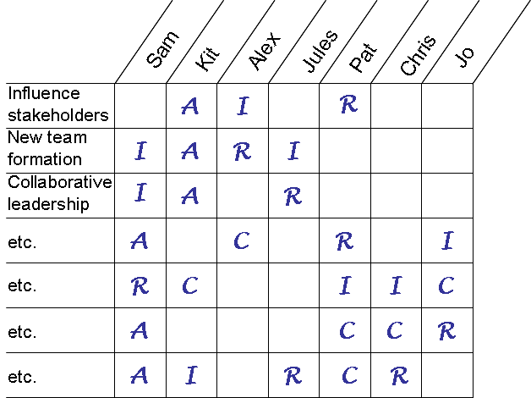
RACI – A practical and pragmatic tool to help clarify roles and responsibilities
Responsible
“Doers” who act on or implement decisions. The degree of responsibility is determined by the person who is accountable. There can be more than one responsible person.
Accountable
“The buck stops here” because this person is uniquely accountable and has power of veto. There can only be one accountable person in each row.
Consulted
This person is “in the loop” and should be consulted prior to decisions or actions. Two-way communication.
Informed
This person needs to know about decisions or actions on an “FYI” basis after the fact. One-way communication.
Notes:
Here are the answers for the card sort exercise.

Slide 12
Group Exercise
In your groups, make introductions and then identify a thorny issue, preferably live, and think about:
What is the responsibility of each role in respect of this issue?
What is your authority to act?
Who is accountable?
How will you work together in this scenario
What would your role be?
If, e.g., you were looking at flow, do you understand what your role is in relation to each other?

Slide 13
Issues
Does someone have too much responsibility? Delegate to a more appropriate role or use as a development opportunity for others
Is someone not performing? Use the tool to hold a conversation to introduce the subject and resolve this
Use (informally if appropriate) at the beginning of a project to give clarity from the start
Highlights who else needs to be involved. Accountability without authority is problematic in the extreme

Slide 14
Further reflection
What issues has this highlighted that need resolving?
How might we do this?
Who else needs to be involved?
Any further reflections?
Focus for the next session?

